Slide 1
An Introduction to Thermal Imaging + Some Random Thoughts on Heat
Chris Dodge
Saffron Walden Community Energy.
See also this useful Which? article:
https://www.which.co.uk/reviews/insulation/article/how-to-use-a-thermal-camera-to-cut-energy-bills-aZzS22N7CDyK

Slide 2
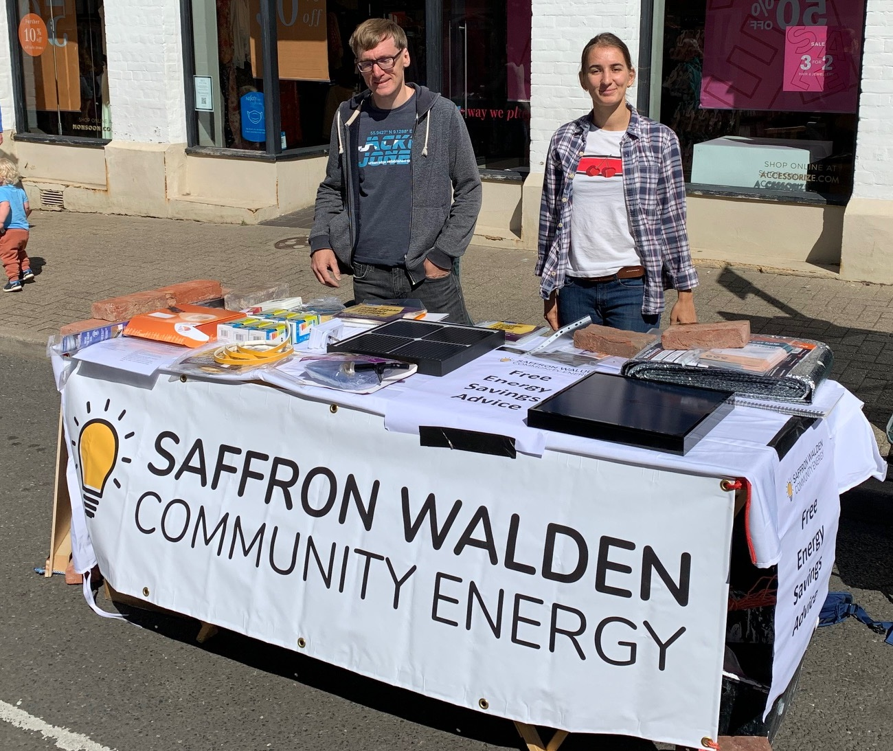
About SWCE
Established in 2021 with the aim of supporting the transition to zero-carbon energy locally.
We’re a Community Benefit Society
Initial support from Essex County Council and Community Energy South
Work primarily through volunteer input and grants funding

Slide 3
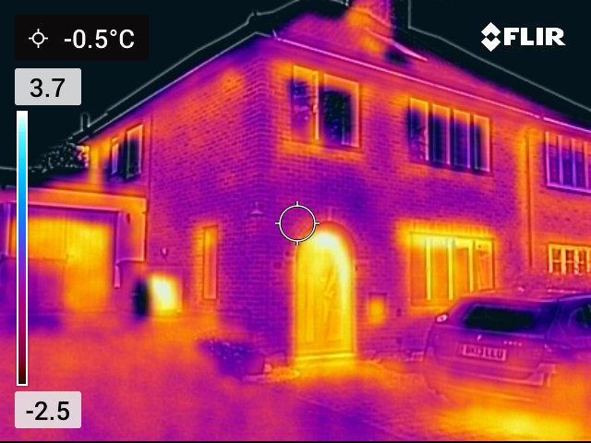
What is Thermal Imaging?
Give yourself a sixth sense – see temperature variations
Primarily qualitative
Our aim:
See where heat may be leaking from home
Try and understand what’s going on!
Basis for further investigation, fixing or retrofit
Notes:
Qualitative as it gives a feel for where areas are warmer or colder than we think they should be.
Difficult to calculate absolute heat loss values as:
So many factors at play in determining the temperature of an area, e.g. is it wet, is the wind blowing, have we recently had sunlight etc.
The emissivity of different surfaces means that the temperature value is only approximate (see later).

Slide 4
Science (Just a Little!)
The Electromagnetic Spectrum
Radio waves
Infrared
UV
X-rays
Gamma rays
Visible light
Not to scale!
HEAT
Increasing frequency & energy
Notes:
The detail here depends somewhat on the audience.
This diagram is not to scale!
Shows the small part of the visible spectrum, and infrared is quite a big block at a slightly lower energy than visible light.
The frequency of the radiation and hence the energy (E = hf) gets higher as we go right. Ionising radiation starts in UV.
We’re interested in the infrared area., which is what we feel as heat.

Slide 5
Thermal Cameras
Shows surface temperature – not x-ray
Can reveal deeper structures
Use a false colour map, for example
Orange/yellow = hot
Blue/black = cold
Combines a visible image with a heat image
Heat image is low resolution
For example, the FLIR C5
5-megapixel visible camera
19,200 pixel (160 x 120) thermal image
Notes:
We’ve run out of visible colours, so have to use a false colour image. There are various options available, but the standard one is probably the most intuitive.
Due to the low IR camera resolution, the hot and cold areas are shown more as blobs, superimposed on a visible image.

Slide 6
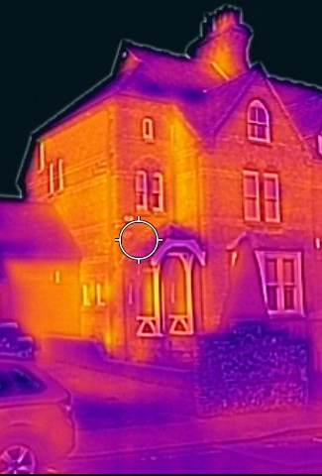
Imaging from the Outside
Have at least 10°C temperature difference between inside and outside
Should be dry and no strong winds
Ideally daylight but avoid direct sunlight
Allow heating to be on inside for a while
Yellow & orange = bad.
Blue & black = good.
Simples! But various pitfalls.

Slide 7
Typical Example
Patchy cavity wall insulation?
Windows warm and cold! What’s going on??
Workshop leaking heat
Heat leaking from porch
Heat pump - hot and cold

Slide 8
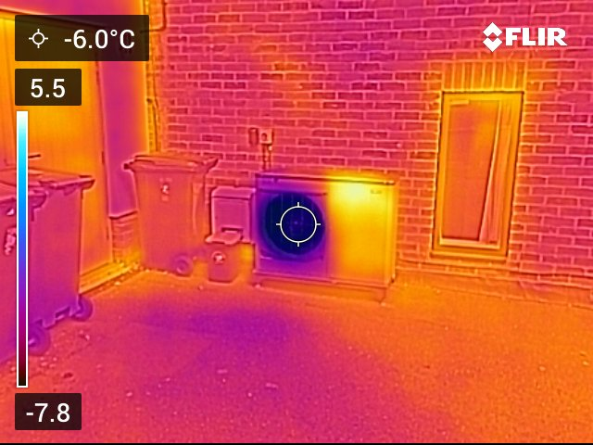
Checking out the Heat Pump

Slide 9
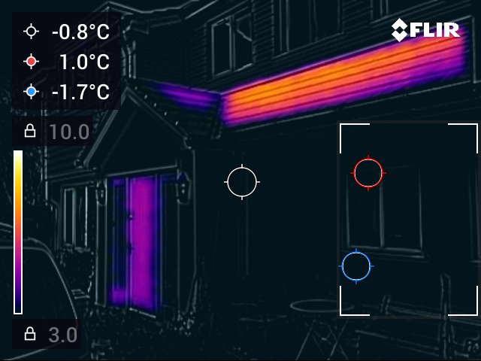

Slide 10
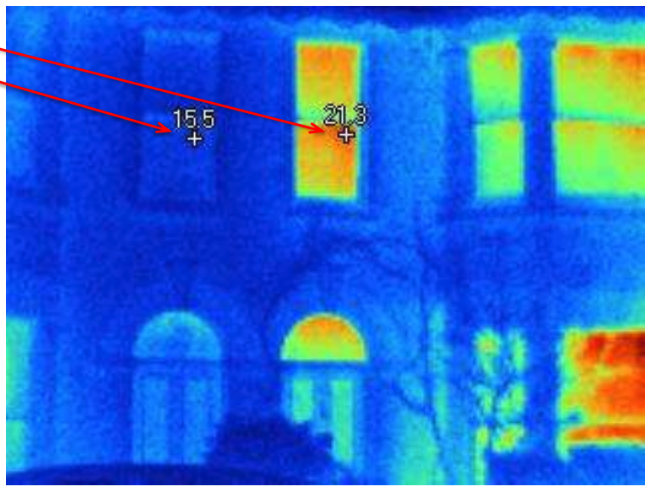
Is the House/Room Heated??
Left: Low thermostat & secondary glazing
Right: House kept a lot warmer
Thanks to Cambridge Carbon Footprint

Slide 11
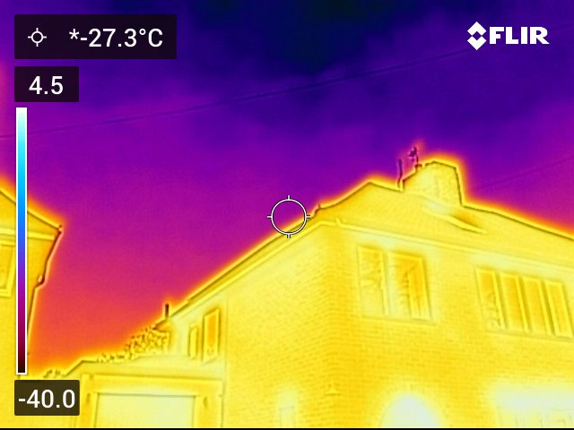
Care with Auto-Scaling
Don’t point at the Sky, this will Measure the temperature of upper atmosphere!
And hence, Poor temperature resolution in area of interest

Slide 12
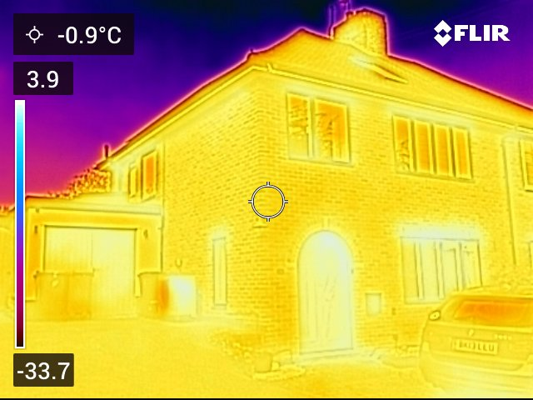

Slide 13
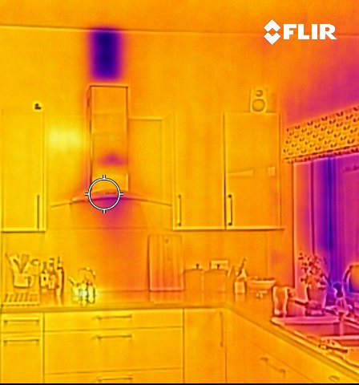
Imaging from the Inside
Need the inside/outside temp difference
Generally yellow & orange = good
Generally blue & black = bad
Understanding home construction useful
Some pitfalls here as well

Slide 14
What’s significant?
Outside wall
Inside wall
Outside wall (Orange Ring) cooler by 1.8°C than inside wall (Blue Ring). Improved insulation would help

Slide 15
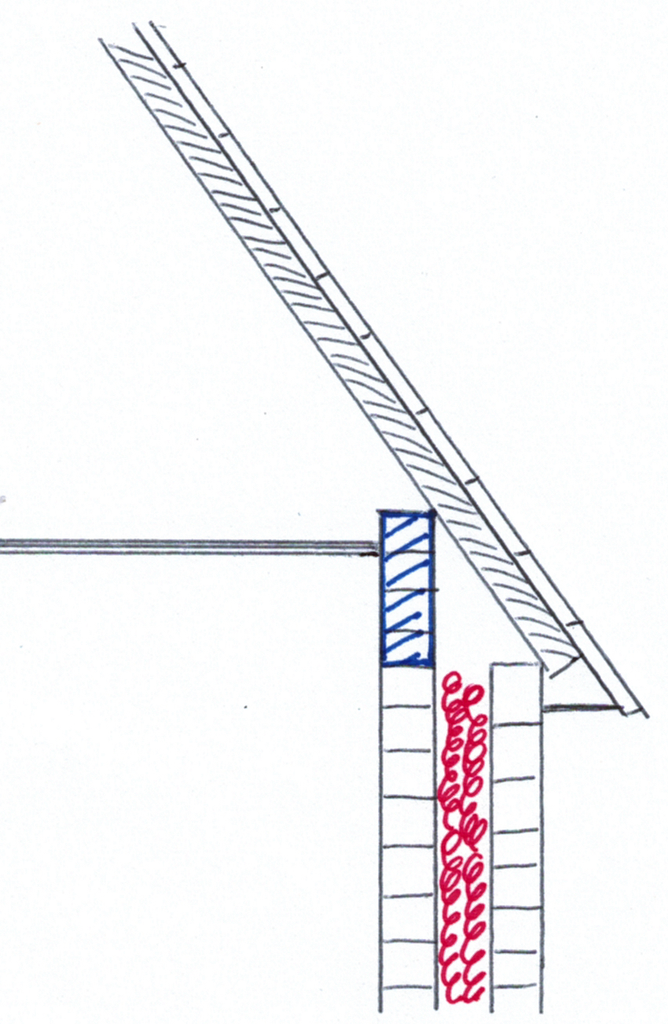
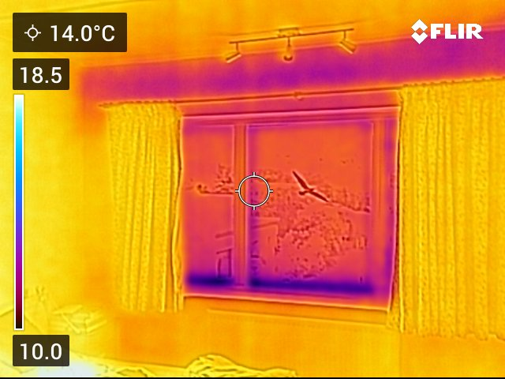
Understanding home construction can help
Cold area

Slide 16
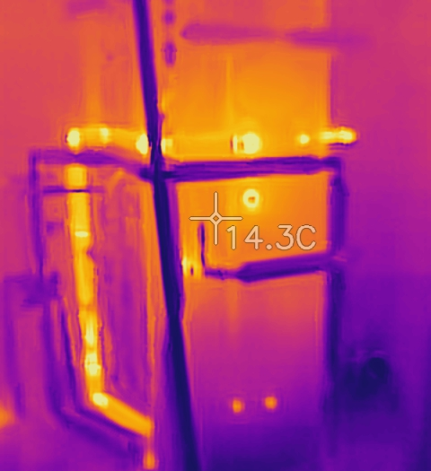
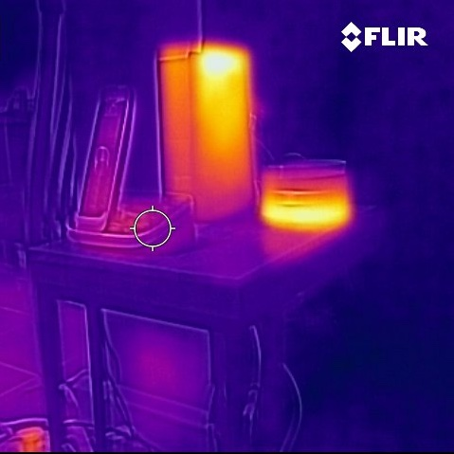
Check for wasted heat inside

Slide 17
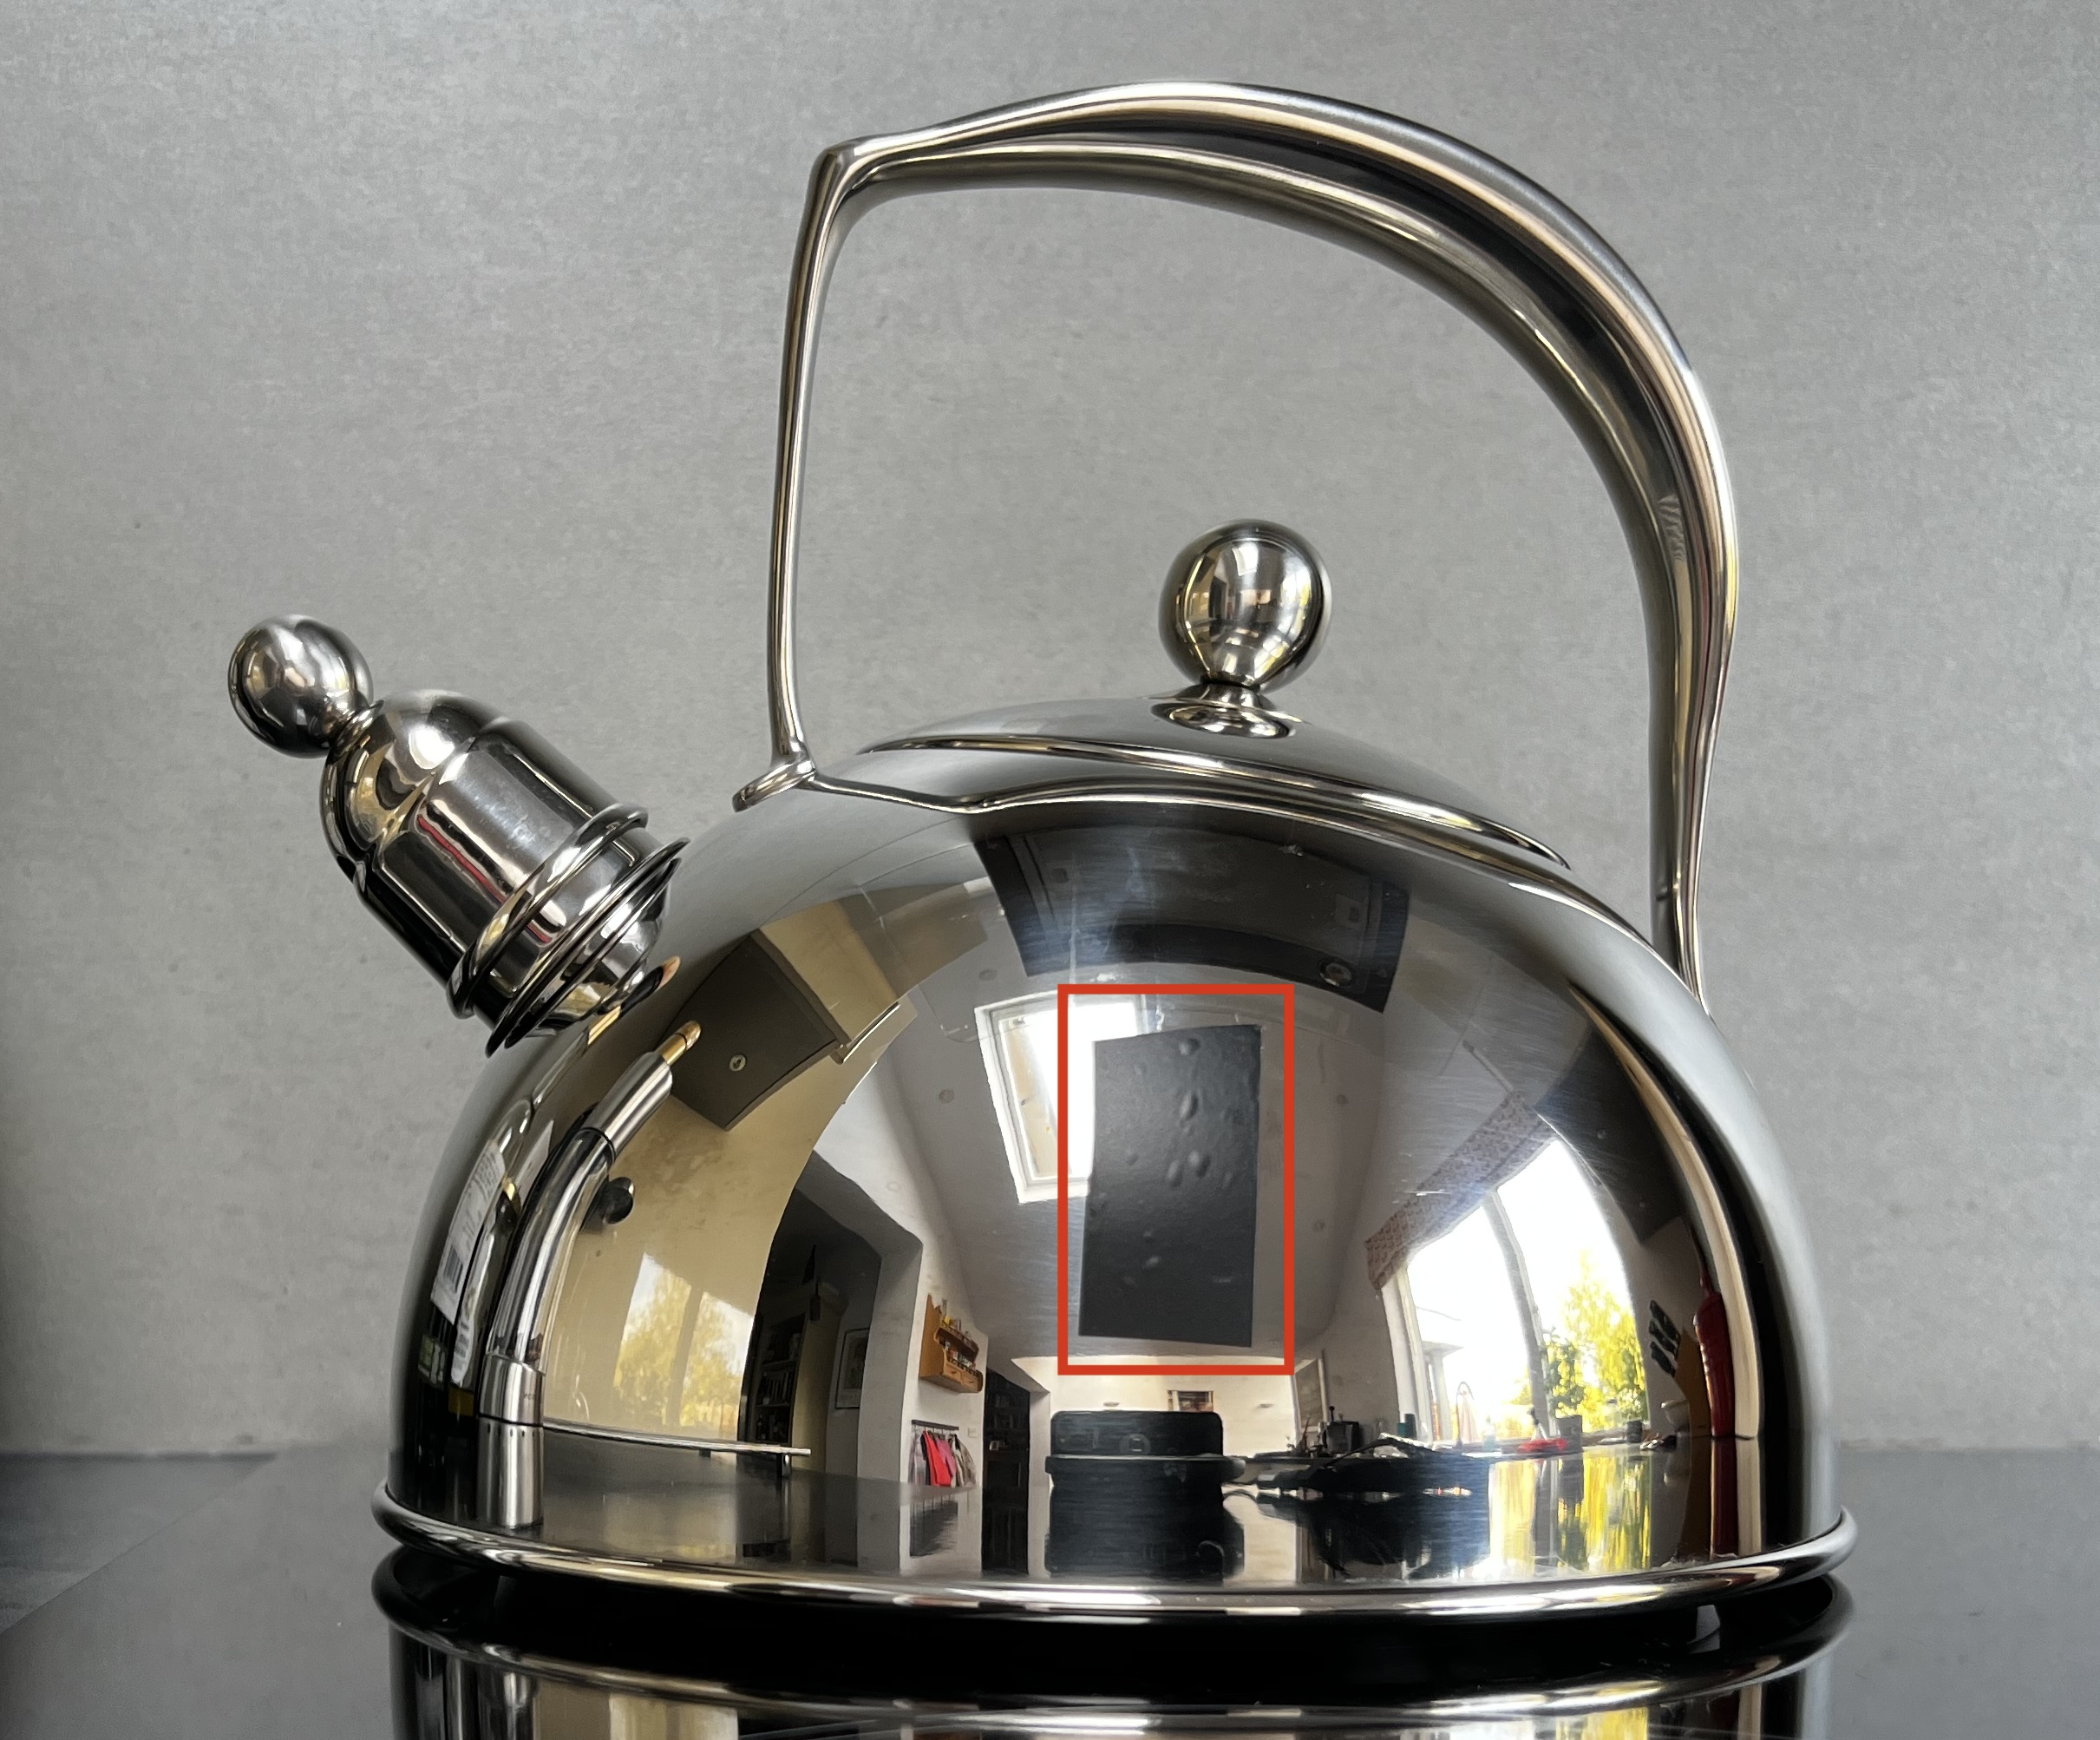
Emissivity
Different materials radiate different amounts of heat
With low emissivity, they will appear cooler in the camera
Fortunately, we have a rule of thumb: If reflective then it is a bad radiator.

Slide 18
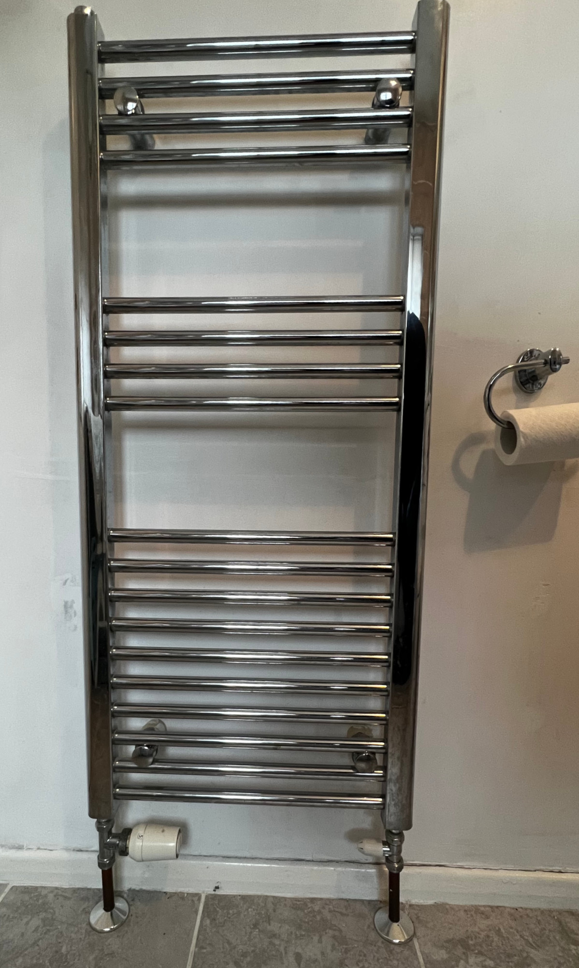
Poor radiator design for heating:
Minimal radiation
Low surface area for conduction
Often covered in towels

Slide 19
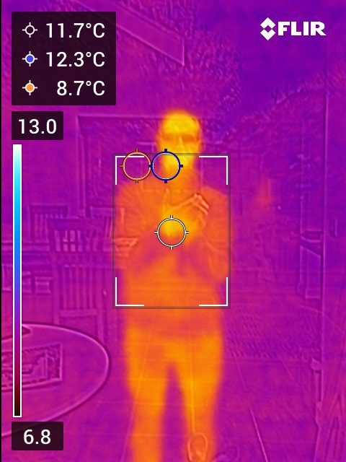
Windows – Can be awkward
Glass will reflect some IR, so can be partially measuring reflection
Newer glazing often has an IR reflective coating
Use a piece of tape on glass to see actual temperature
At an angle of ~45° all light/IR reflected

Slide 20
COLD??
Angle: Probably reflecting sky temperature
Or: Double / Triple Glazed or is room unheated?
WARM
Single glazed windows

Slide 21
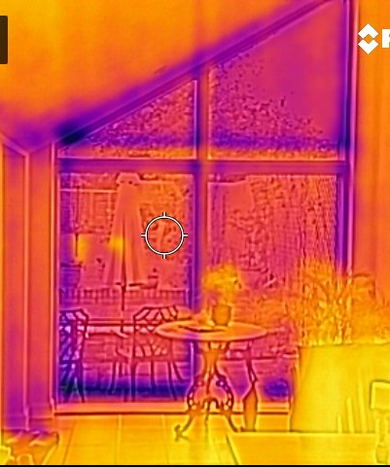
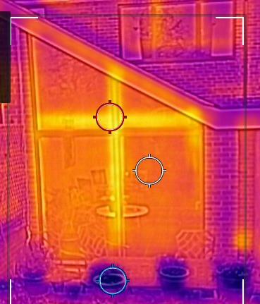
Windows – Usually look thermally poor

Slide 22
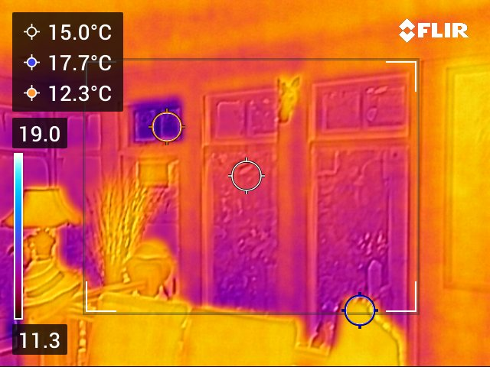
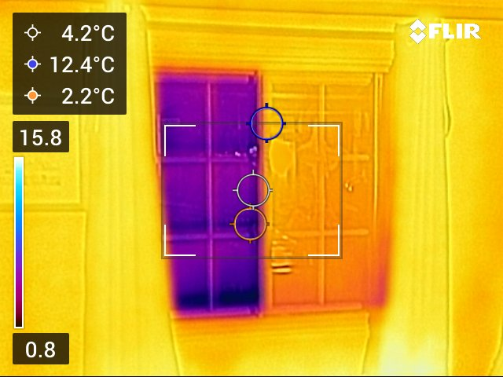
Single Glazing is not good!

Slide 23
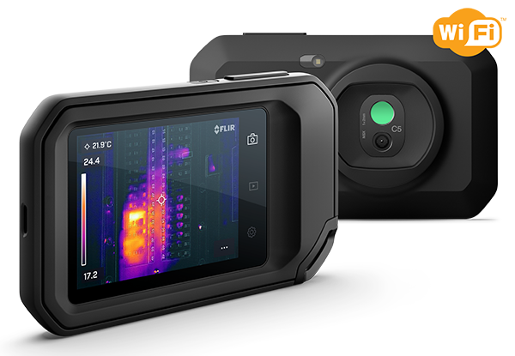
Using the Camera – FLIR C5 (& C3)
Lamp
Visible & IR
cameras
Touch screen
On/off + shutter buttons

Slide 24
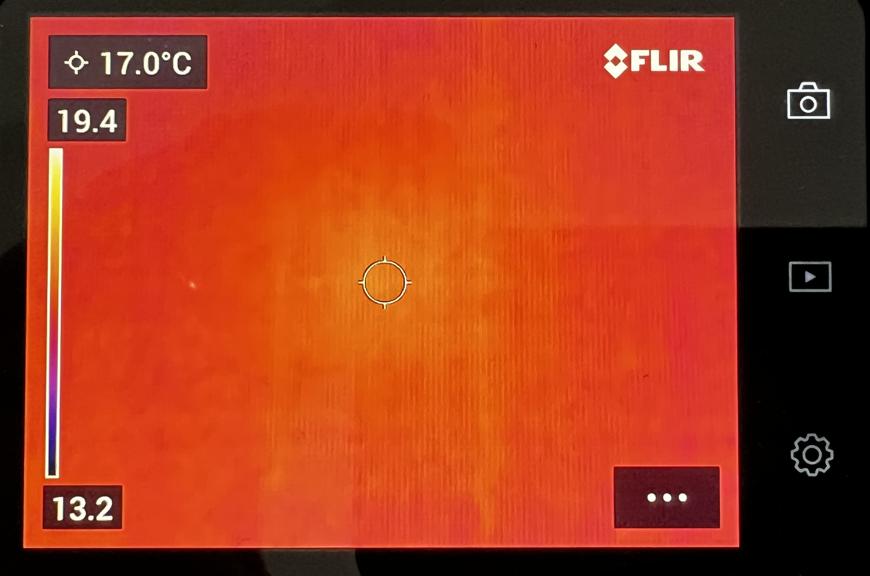
Live View
Centre spot temperature
Gallery
Temperature scale
Settings
Menu

Slide 25
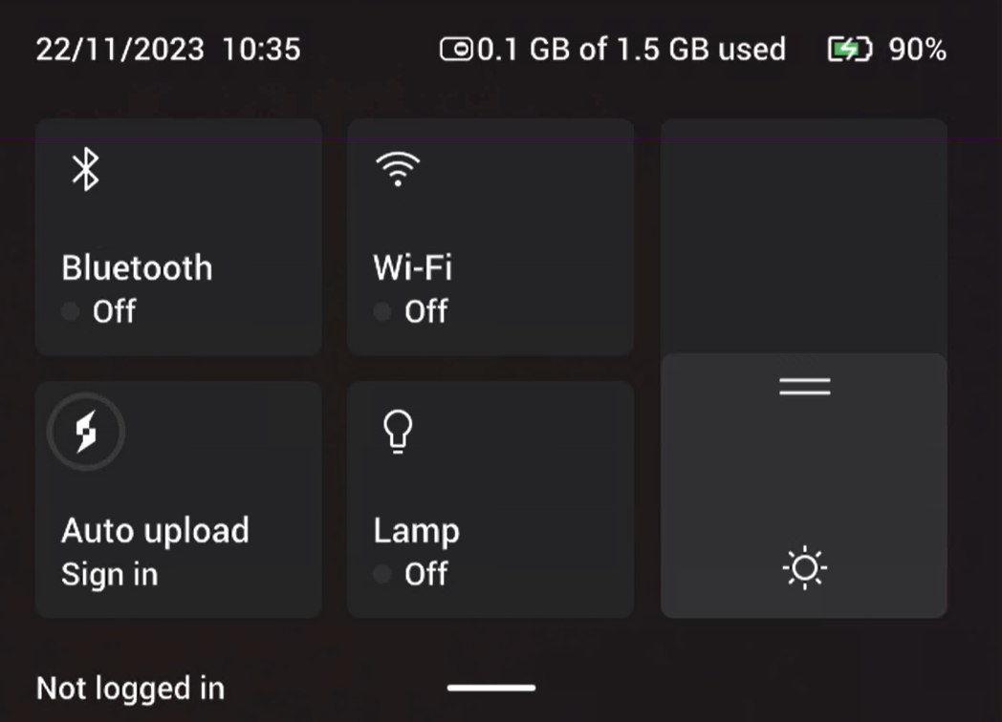
Swipe down

Slide 26
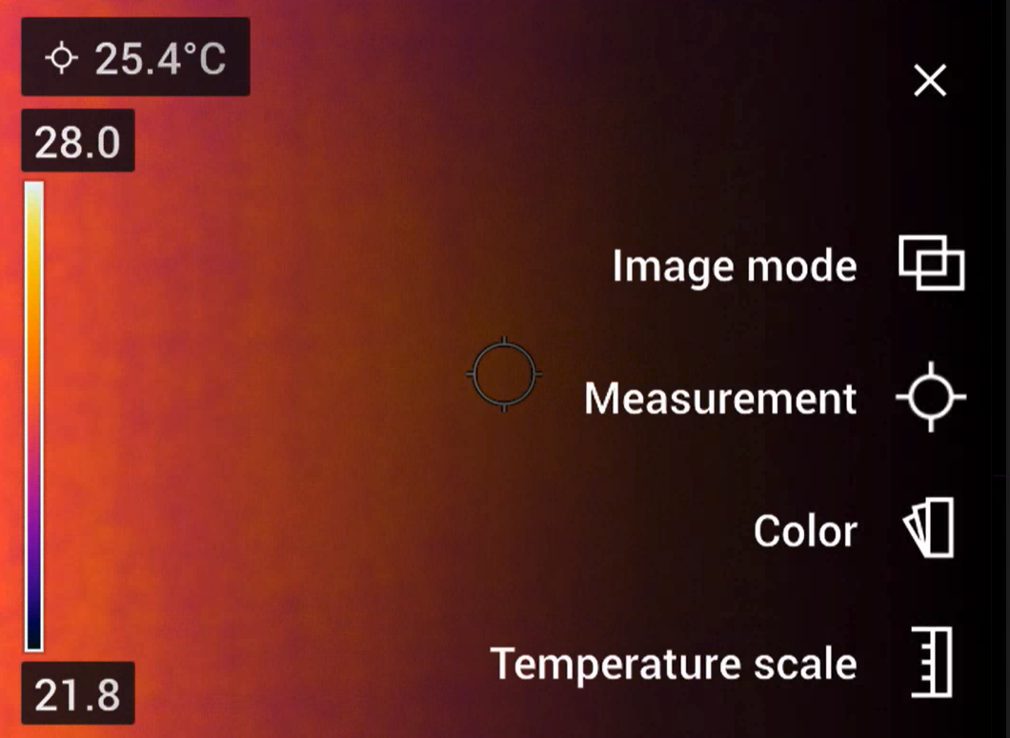
The Menu
To make imaging as
useful as possible

Slide 27
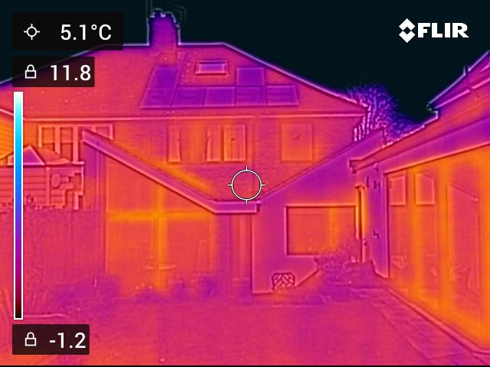
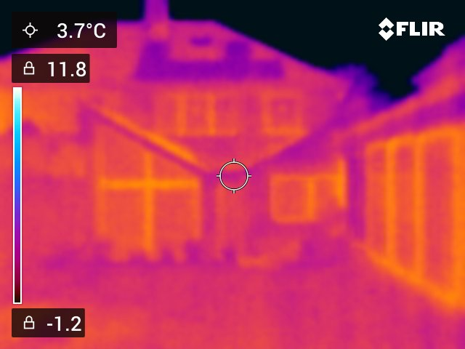
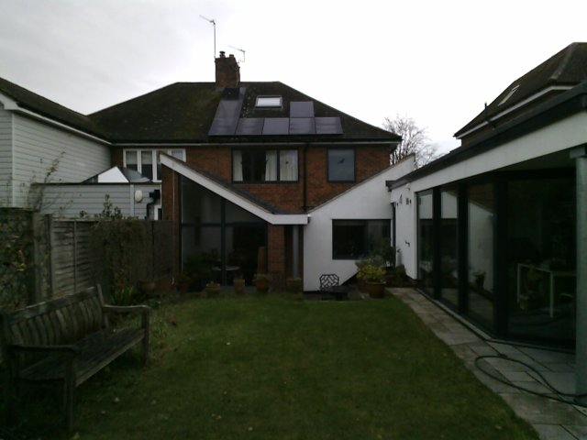
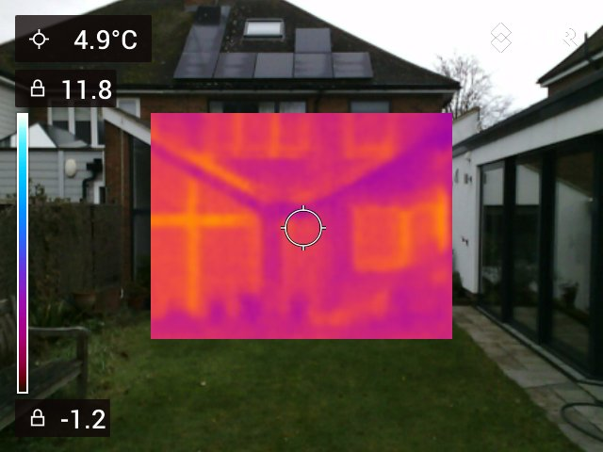
Image Mode

Slide 28
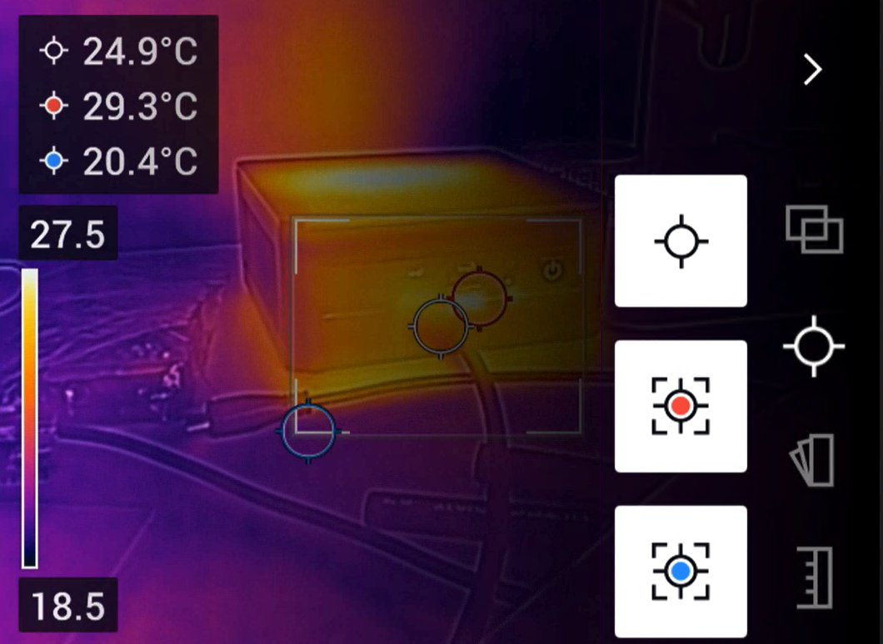
Measurements
Centre point
Max temperature in square
Mini temperature in square

Slide 29
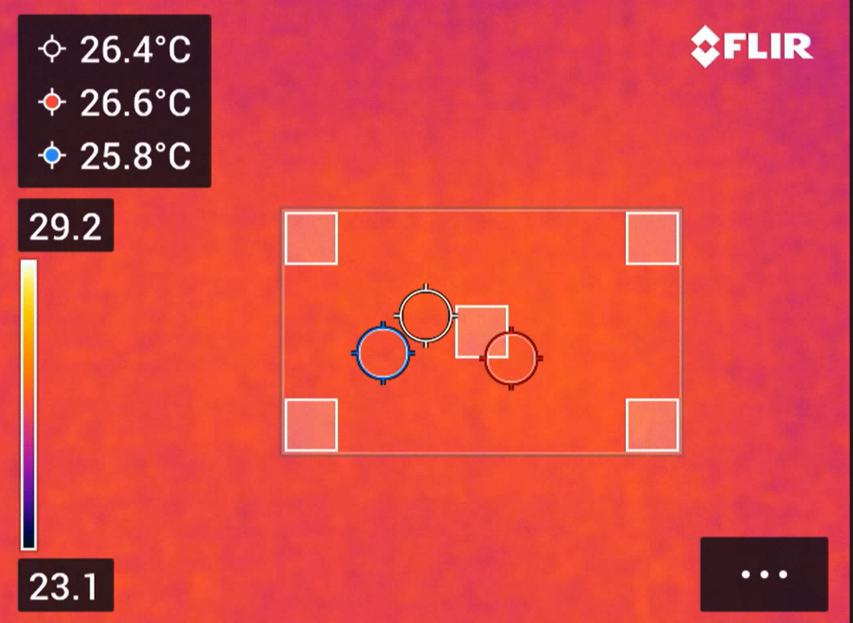
Adjust area of interest

Slide 30
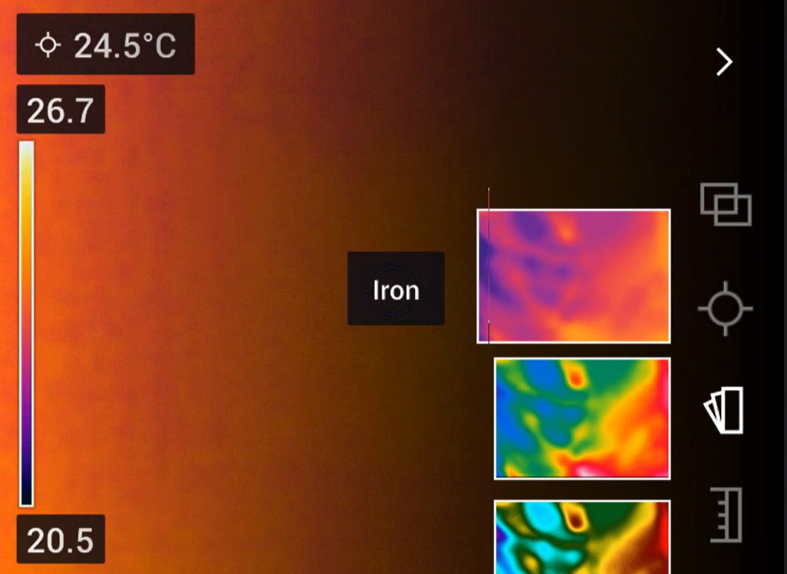
Colour Scale
Changes how IR is represented
Default is Iron

Slide 31
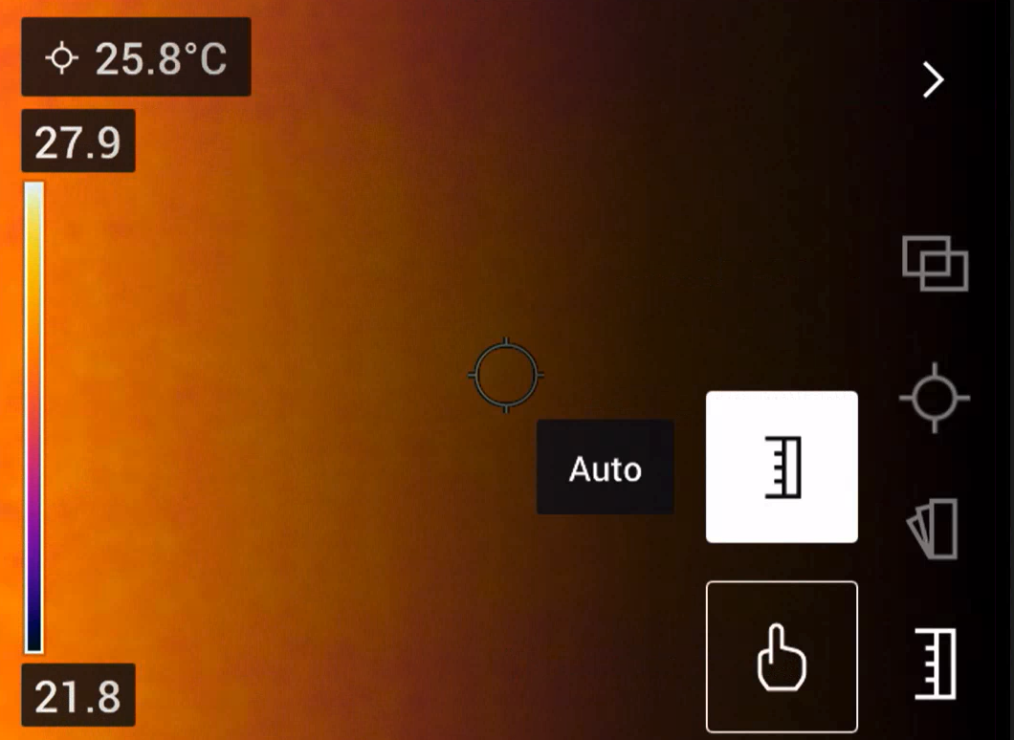
Temperature Scale
Can be useful to get most out of the camera

Slide 32
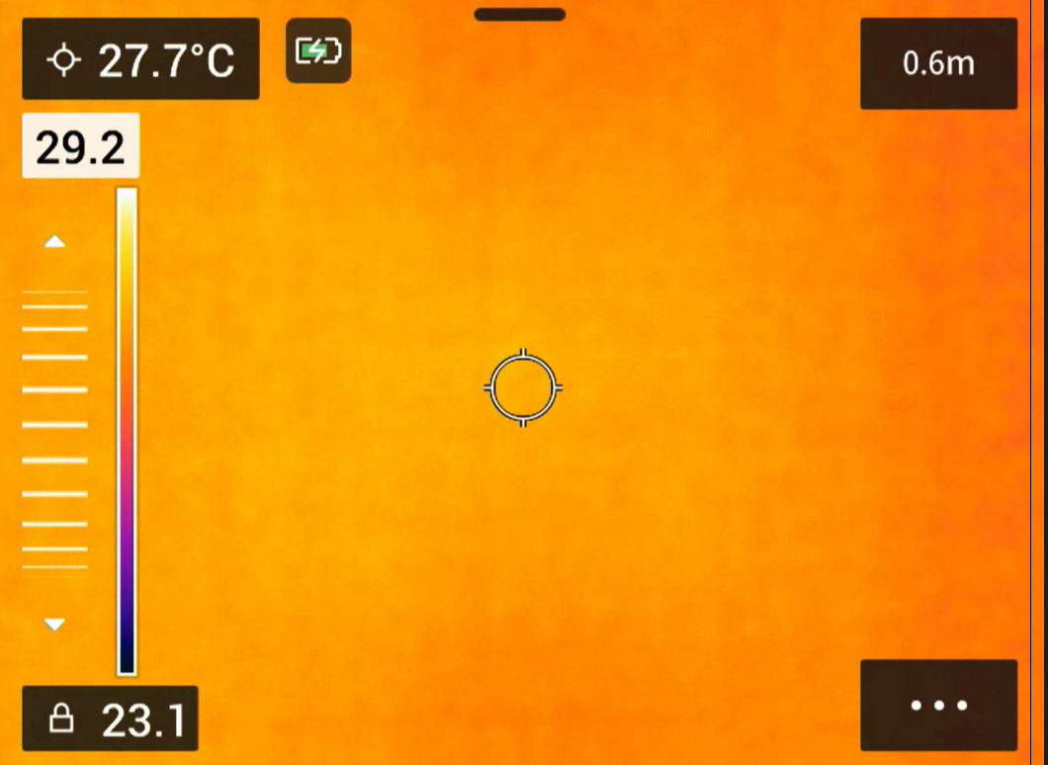
Max temperature
Jog wheel to adjust
Min temperature
- currently locked

Slide 34
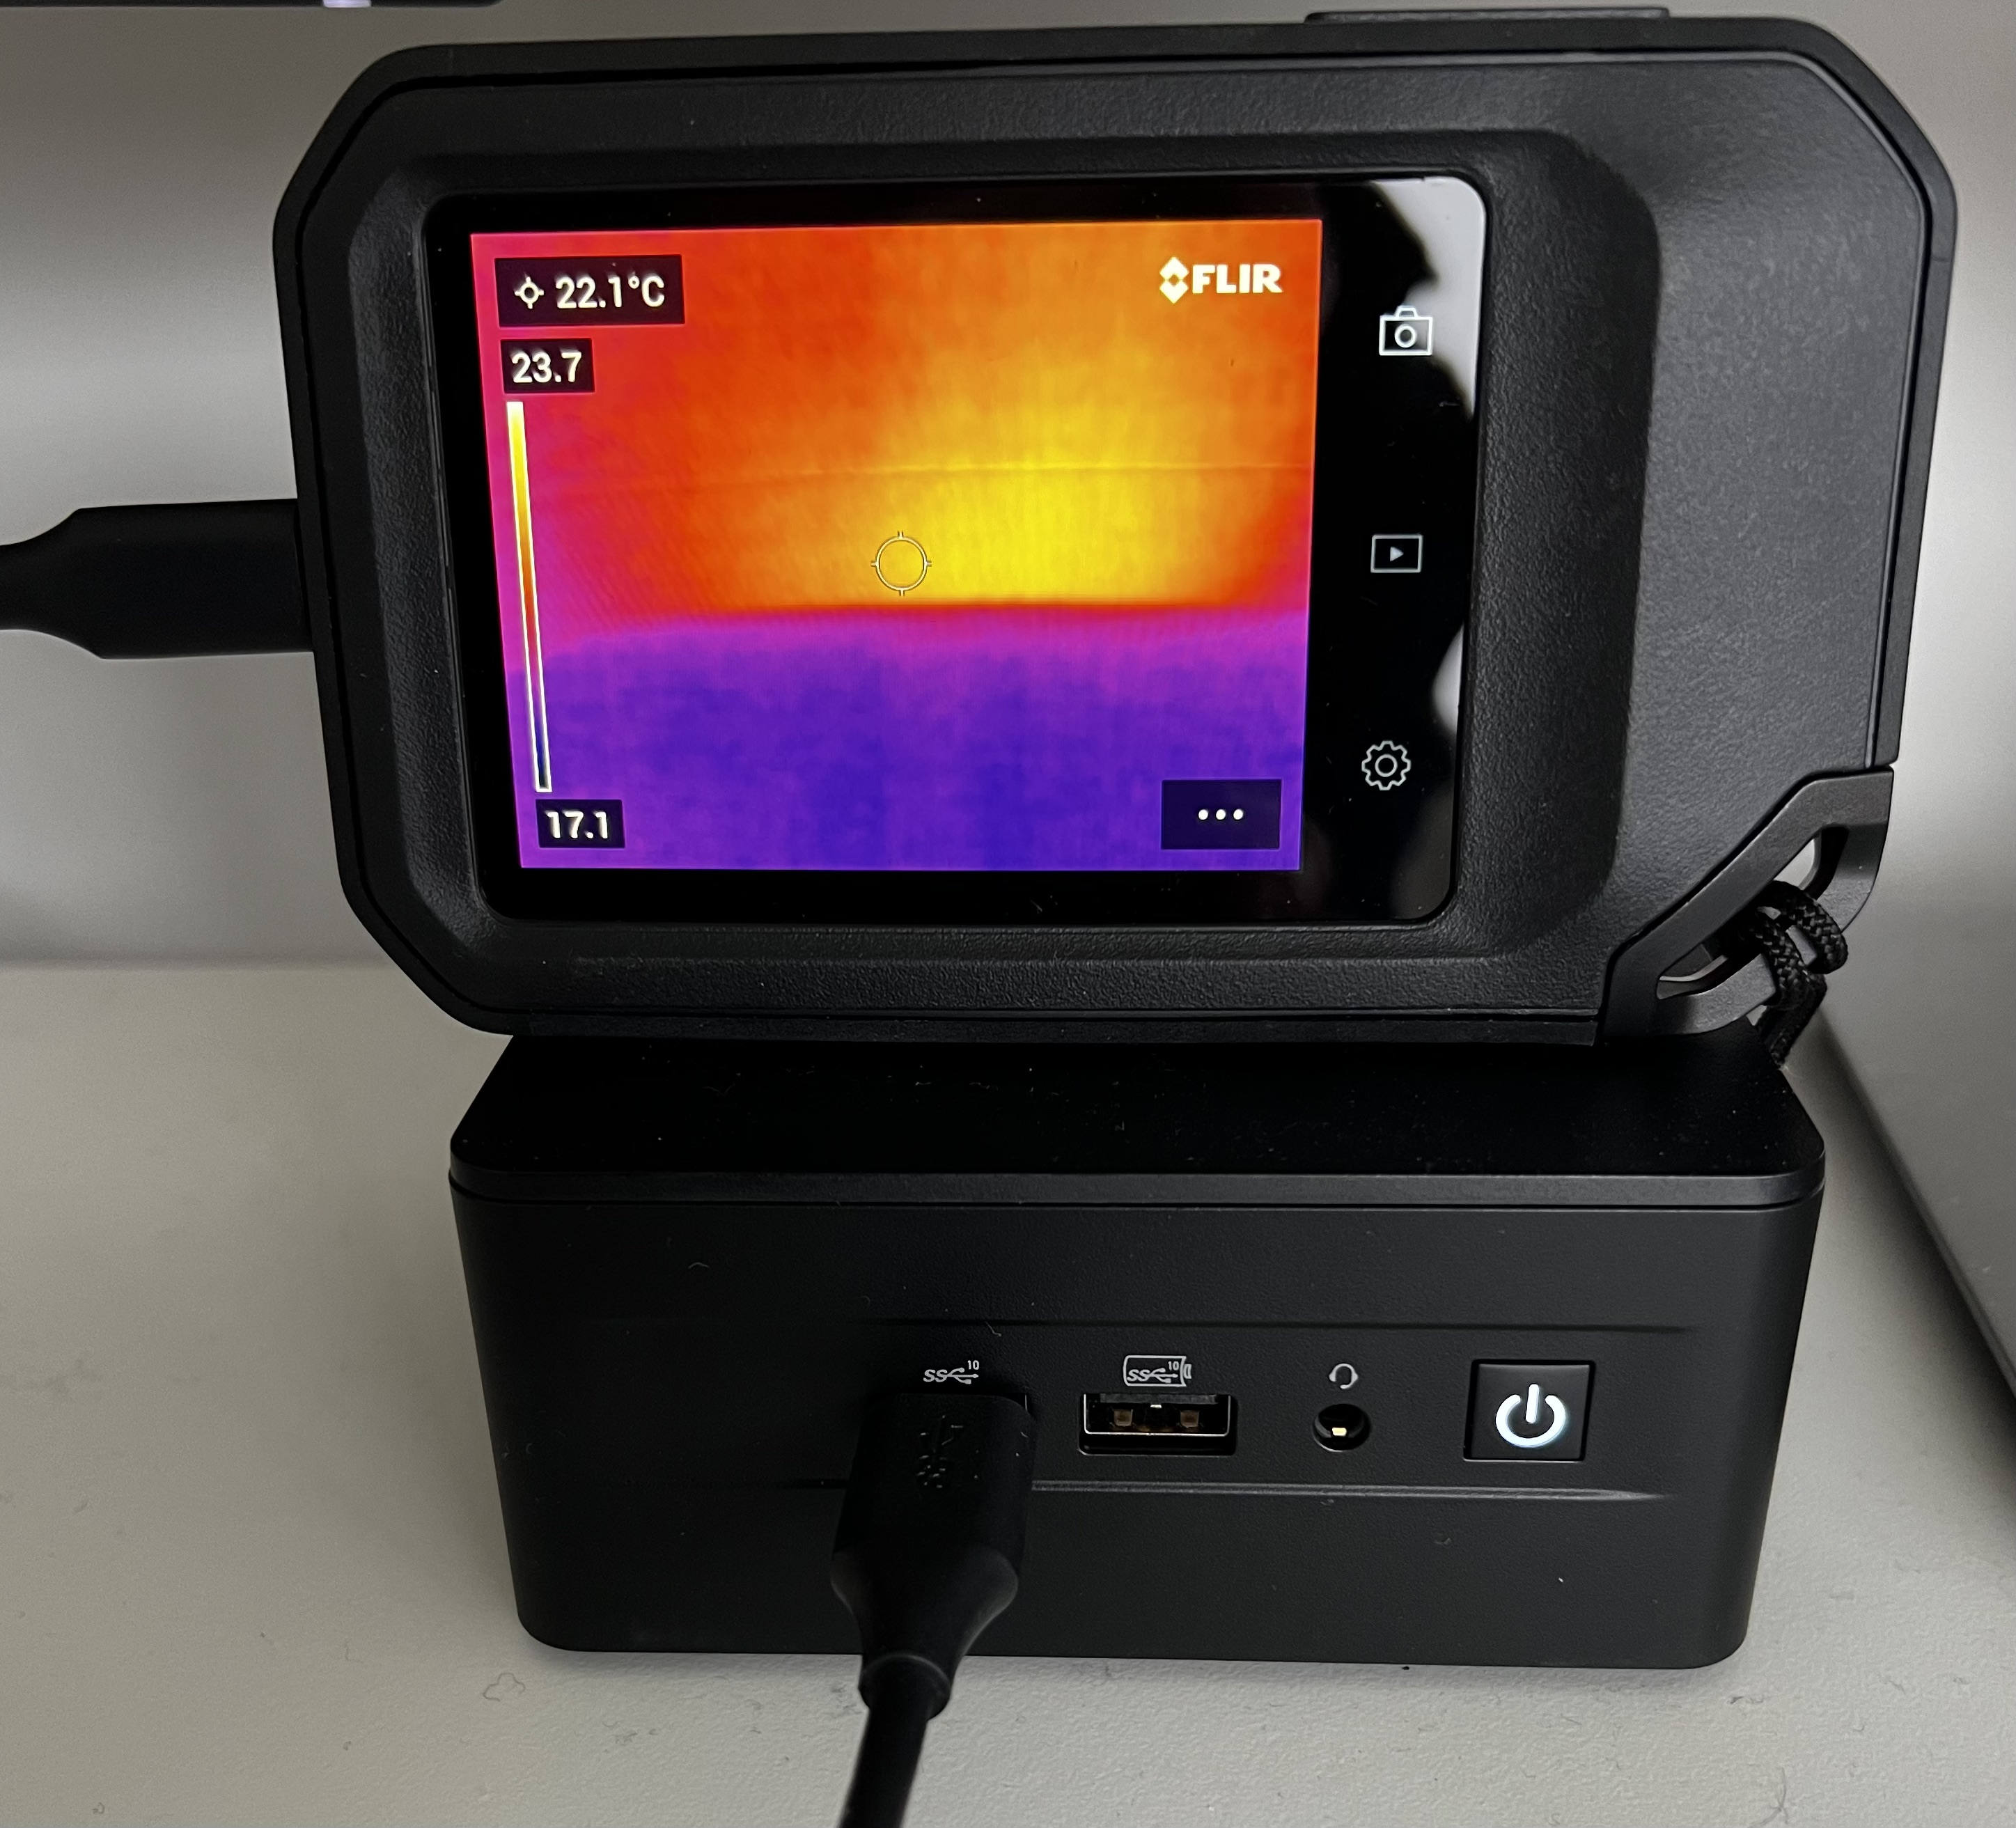
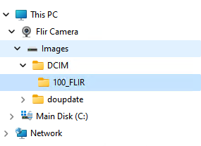
Transferring Images
Connect to PC via USB
Windows: It should appear as “Flir Camera”
Mac: Need the “Android File Transfer” app.

Slide 35
The Loan Scheme Instructions for Littlebury Parish
Charlotte and Ian Dunham (07969 439666, charlotte_dunham@hotmail.co.uk) hold the schedule of those who have asked to borrow one of the cameras.
We will deliver the camera and give a short demo or carry out the survey if requested
If the camera is being left with you, we will arrange a time to collect the camera back/for you to deliver it back to us, allowing for suitable time to complete your survey ( this can be weather dependent as below).
Hopefully, conditions will be good for imaging (Dry, at least 10ºC differential between inside and outside, and your heating is on).
Please charge the camera and (unless point below applies) remove your images before returning
If you are happy to share your images with us, particularly if interesting or useful examples, please leave these ones on the camera, or otherwise share if you have downloaded to your computer.
Please give feedback as requested (via short email questionnaire).

